Slide 1
Introducing Azure Kubernetes Service on Azure Stack HCI AKS on Azure Stack HCI

Slide 2



Azure Hybrid
Innovation anywhere with Azure
Azure
Single control plane with Azure Arc
Bring Azure services to any infrastructure
Modernize datacenters with Azure Stack
Extend to the edge with Azure IoT

Slide 3


Kubernetes on Azure
Enterprise-grade by design
Built-in best practices
Multi-layer security
Enterprise support
Unified management
Proactive and actionable recommendations, based on knowledge from thousands of enterprise engagements
Hardened security and layers of isolation across compute resources, data, and networking
Support from certified Kubernetes experts or an interactive portal experience for faster diagnostics and troubleshooting
Consistent configuration and governance across environments
Notes:
Now unless you’ve been hiding under a rock, you’ve likely heard of Kubernetes, but for those of you that haven’t, what is it? Well, as application development moves towards a container-based approach, the need to orchestrate and manage resources is important. Kubernetes is the leading platform that provides the ability to provide reliable scheduling of fault-tolerant application workloads. AKS in Azure, is a managed Kubernetes offering that further simplifies container-based application deployment and management and has several key benefits.
As a managed service, not only do you benefit from the simplicity, but you also benefit from all the learnings of Microsoft engineers building AKS, thousands of engagements with enterprise organizations, and deep integration with the open-source community, in the form of comprehensive best practices and recommendations for running AKS-based applications and services. Security is part of AKS by design, with multiple layers of hardening and isolation, and in addition, we’ve published a security baseline for AKS which contains recommendations that will help you improve the security posture of your deployment. AKS is also fully supported by Microsoft support, which is made up of certified kubernetes experts who can help diagnose and troubleshoot any issues you may run into.
Finally, you can manage your AKS resources side by side with non-Azure based kubernetes resources, all from the Azure portal – enabling you to manage applications consistently, apply governance and policy, and more.

Slide 4
What we are hearing…
I want to be able to write applications for Azure but run them in my datacenter.
Don’t tell me that I will need more people to manage and maintain my application infrastructure.
Moving to hybrid cloud cannot require me to throw out everything and start from scratch. I have existing solutions that need to be evolved.

Slide 5
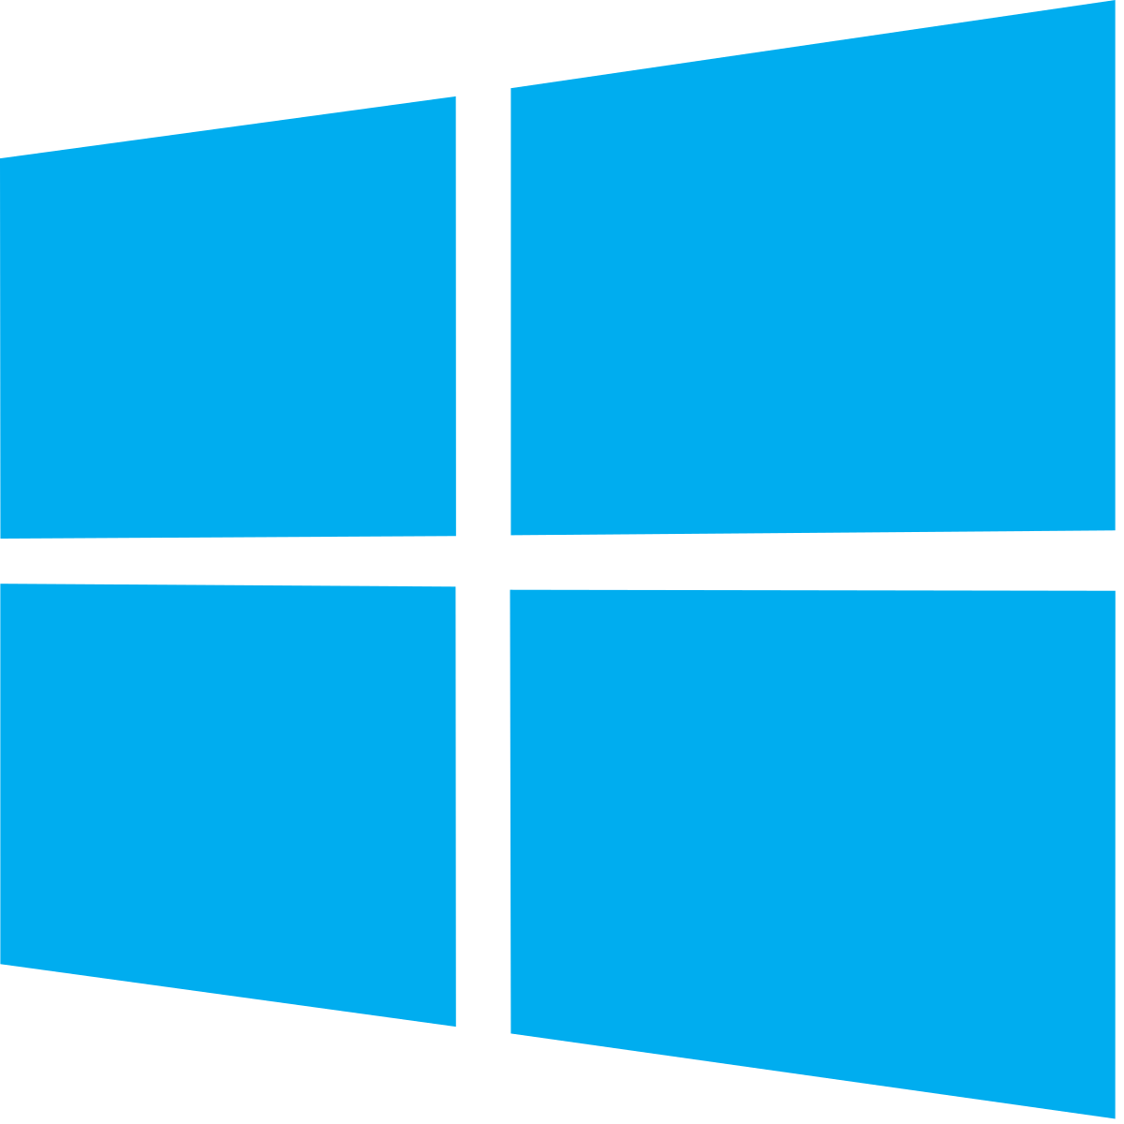

AKS on Azure Stack HCI
Familiar Kubernetes application platform available on Azure Stack HCI
+
+
Azure hybrid by design
Best platform for .NET apps on-premises
Built-in security
AKS-consistent Kubernetes cluster management
Easy AKS deployment on Azure Stack HCI
Built-in Azure Arc capability
Support for both Linux and Windows applications
Differentiated container solution for Windows
Local administration with Windows Admin Center
Secure and trusted platform
Single and consistent identity
Always up-to-date like Azure

Slide 6
Azure hybrid by design
AKS-consistent Kubernetes cluster management
Centrally managed from Azure Portal
Fleet management for Kubernetes platform and containers
Easy AKS deployment on Azure Stack HCI
“Single”-step installation and update of a fully-conformant Kubernetes cluster
Built-in logging, monitoring, load-balancing, and certificate management
Built-in Azure Arc capability
Easily bring Azure services on-premises with Azure Arc
Consistent identity and security

Slide 7



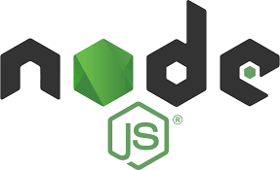

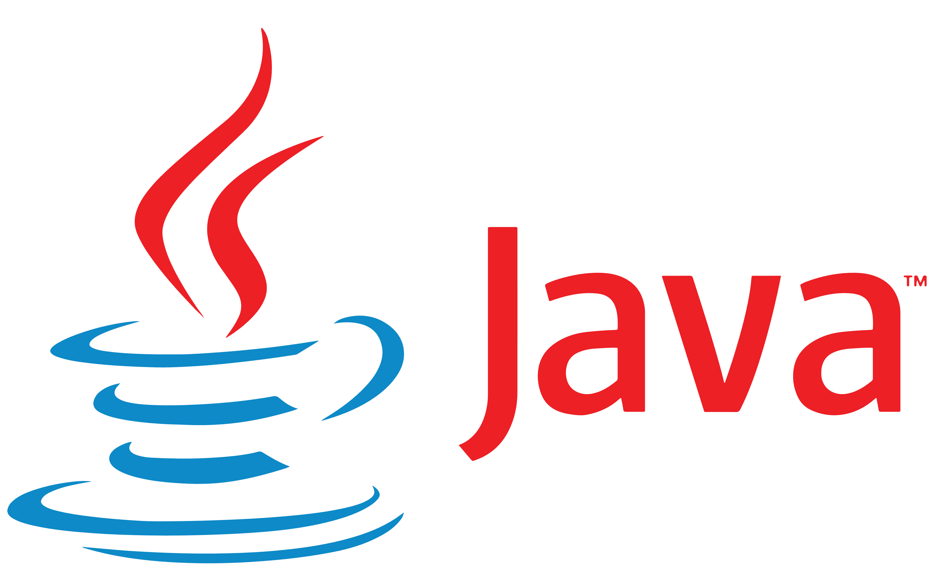














The Azure Hybrid view
Azure Arc
Cloud management
Applications
Windows
Server
Linux
Containers
Azure data services
Arc-enabled data controller
Virtual machines
Any size and configuration
AKS on Azure Stack HCI
Container orchestration platform
Azure Stack HCI
Hyperconverged infrastructure software stack
Hardware ecosystem
200+ solutions, validated by Microsoft
Admin Center
Edge-local management

Slide 8






Architecture
Azure Arc control plane to project your K8s clusters into Azure
Azure Portal
Kubernetes.io compliant OSS components
AKS on HCI
Microsoft provided OSS code: CSI + CNI + Cluster API works across all K8s implementations
Linux and Windows container host virtual machines automatically updated from Azure
Azure Stack HCI
Admin Center
Notes:
But what is going to get deployed? Well, architecturally, at a high level, at the base, you have Azure Stack HCI running on the metal. On top of that, in virtual machines, AKS-HCI deploys container hosts, both Windows, and Linux which will ultimately run your workloads. In the case of Linux, this is Microsoft’s Mariner OS - These are updated directly from Azure, but obviously you control when you apply those. In addition, Microsoft has built the integration for Kubernetes to work effectively with the underlying compute, storage, networking and clustered infrastructure in Azure Stack HCI, and combines this with the Kubernetes open source software, and that, bottom to top, is the AKS-HCI solution.
Then on top, you can run your kubernetes applications, optionally managed from Azure Arc.

Slide 9


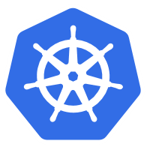



Azure Arc
Multi-cloud
Datacenter & hosted
Organize and govern across environments
At-scale Kubernetes app management
Run Azure data services anywhere
Get Kubernetes clusters and servers that are sprawling across clouds, datacenters and edge under control by centrally organizing and governing from a single place.
Deploy and manage Kubernetes apps at scale across environments using DevOps techniques. Ensure that apps are deployed and configured consistently from source control, at scale.
Run data services where you need for latency or compliance. Stay current with evergreen SQL and seamlessly manage and secure your data assets across on-prem, clouds, and edge.
Notes:
But what is Azure Arc? For those of you not familiar, Arc provides a number of benefits and capabilities – firstly, it provides a powerful, centralize way to organize, manage and govern resources at scale with powerful scripting tools, the Azure portal and APIs. You can bring modern cloud native development techniques anywhere to build iteratively on your choice of any certified Kubernetes distribution, of which AKS on Azure Stack HCI is one. And on top of all of that, you can run Azure data services on-premises, at the edge, and in multi-cloud environments using Kubernetes on the infrastructure of your choice – this could be Azure SQL Managed Instance or Azure PostgreSQL Hyperscale, delivered to your chosen kubernetes environment, orchestrated through Azure Arc.

Slide 10
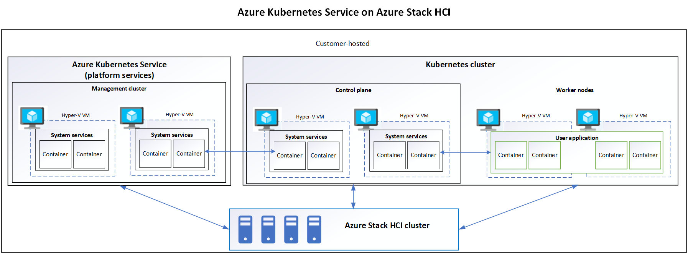
Architecture – AKS-HCI Components
Notes:
Now, to dig one layer deeper, when you deploy AKS-HCI, there are actually 2 major steps. The first, on the left here, is to deploy the platform services, also known as a management cluster. This deploys a couple of VMs (just one in preview) that essentially orchestrates and controls deployment and management of the target clusters, here on the right. This is where you run your applications and workloads. When you deploy kubernetes target clusters, AKS-HCI automatically deploys a set of VMs to act as the control plane for the target cluster, including at least one load balancer.
So, that’s everything that get deployed, but what are your options for deployment?

Slide 11
Best platform for .NET apps on-premises
Built-in support for both Linux and Windows
All-inclusive and fully-supported infra-ready to run Windows and Linux containers out-of-the-box
Single vendor support leading to faster turnaround on support and fixes
Differentiated container solution for Windows
Domain credentials in containers with gMSA v2
AD and Azure AD integration​
Local administration with Windows Admin Center
Windows Admin Center and PowerShell for the Windows experts
Integrated Windows app migration tooling

Slide 12
Built-in security
Secure and trusted platform
Secure endpoints and Kubernetes clusters with Azure Active Directory, Azure Security Center, and Azure Sentinel
Runtime protection to defend the K8S platform from attacks and vulnerabilities
Single and consistent identity
Security updates for all components, including OSS
Certificate Authority for secure intra-cluster communication ​
Always up-to-date like Azure
Regular and consistent feature and security updates
Unified Azure billing
Leverage existing Azure support plan

Slide 13

When to use AKS on Azure Stack HCI
Run Kubernetes on Azure Stack HCI and easily connect to Azure services
+
+
AKS applications on Azure Stack HCI
Develop in AKS but deploy unmodified to the edge
Modernize Windows and Linux apps
.Net framework and core apps being containerized
Data Services on Azure Stack HCI
Run Azure Arc for Data Services on a resilient platform

Slide 14
Deployment Options
PRODUCTION
EVALUATION ONLY
Apps & Workloads
Apps & Workloads
AKS on Azure Stack HCI
AKS on Azure Stack HCI
AKS-HCI installed on Azure Stack HCI 20H2 multi-node cluster running on validated physical hardware*
AKS-HCI installed on Windows Server 2019 (single Hyper-V host) running on physical hardware, or an Azure VM
* AKS-HCI is also supported on a Windows Server 2019 Hyper-V-based physical cluster
Notes:
Well, you have a couple of options for running AKS on Azure Stack HCI in production, and then an additional option if you have limited hardware and just want to evaluate AKS on Azure Stack HCI.
So, on the left, we have our primary deployment option for production environments – that’s running the new Azure Stack HCI 20H2 operating system on the metal. If you’re not familiar, Azure Stack HCI 20H2 is a hyperconverged infrastructure (HCI) cluster solution that hosts both traditional virtualized Windows and Linux workloads in a hybrid, on-prem environment and is the future of infrastructure investments in compute, storage and networking on-prem. Plus, it’s also available as a subscription so fits with your cloud-billing approach. Azure Stack HCI is also a great place to run AKS-HCI. That combination is our primary option for a bottom to top supported configuration in production.
Now, what if you have existing hardware on-prem, perhaps with SAN storage? Well, Azure Stack HCI 20H2 is hyperconverged, so won’t work with SAN storage, but if you prefer, you can run a Windows Server 2019 Hyper-V-based physical cluster and run AKS-HCI on top.
Finally, if you don’t have much spare hardware, maybe you just have a single physical node – if that’s the case, for evaluation purposes, you can also run AKS-HCI on top of a single Windows Server 2019 Hyper-V host. Better still, if you don’t have any hardware at all, but have an Azure subscription, you can even evaluate AKS-HCI nested in a single Azure VM, and that’s what we’ll show next.

Slide 15
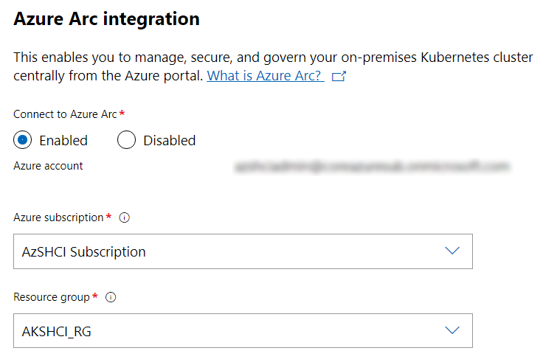
Azure Arc – Onboarding
Windows Admin Center
PowerShell
Install Azure CLI
Register Azure Arc enabled K8s service
Create RG & Service Principal
Install-AksHciArcOnboarding -name $clusterName -resourcegroup $resourceGroup -location $location -subscriptionid $subscriptionId -clientid $appId -clientsecret $password
-tenantid $tenant
Notes:
Now with AKS-HCI, there are 2 ways to optionally integrate with Arc – the first, you would have seen when deploying a target cluster with Windows Admin Center, and how easy it is to enable that Arc integration during deployment. The second approach is to use PowerShell, and this can be performed after the deployment of the target cluster is complete. As you can see, all you need to do is install Azure CLI, register Arc-enabled k8s in your chosen sub, create a resource group and service principal, and then run the PowerShell to complete the onboarding.
What does it look like once onboarded? Let’s take a look…

Slide 16
Call to Action

Slide 17
Start Your Trial
1
2
3
Register
Download
Tutorial
Register for the download, further information and access to technical programs
Install Azure Kubernetes Service on Azure Stack HCI Preview and Windows Admin Center
Guidance to help get the most from Azure Kubernetes Service on Azure Stack HCI evaluation experience
Azure Arc Jumpstart for Arc for K8s: https://azurearcjumpstart.io/
Tech Docs : https://aka.ms/AKS-HCI-Docs
File issues and review the roadmap on GitHub: https://github.com/azure/aks-hci
Get Started Today
Notes:
So, how to get started – well, download the preview, try it out! The links will be on the next slide, but I can assure you, getting started with AKS on Azure Stack HCI is quick and easy, and we have options for those of you who don’t have any spare hardware, by testing in Azure. There’s also a fantastic Azure Arc jumpstart site, where you can continue your learning around Arc for Kubernetes, and more, and again, the links are on the next slide.

